Slide 1
Book and Journal Publishing
Collaboration in Research Dissemination
(Why, what and how?)

Slide 2
Springer
What we do
Who we are
Types of product
Platforms
How you can participate
Suggest ideas
Contribute
Review
Learn

Slide 3
Springer Nature
Springer Nature is one of the largest research publishers in the world
Authors are researchers, professors, and practitioners globally
Books, journals, and databases span topics throughout the fields of medicine, science, and technology

Slide 4
About Me
Senior Acquisitions Editor at Springer NY
Former Acquisitions Editor at Wiley and Elsevier
Publishing in Computer Science and Engineering for 11 years
Work with potential authors on getting published

Slide 5
Variety of Topics
Signal Processing
Audio & Acoustic Processing
Image Processing
Speech Processing
Communications Engineering
Wireless Sensor Networks
Mobile Communications
Internet of Things
Artificial Intelligence

Slide 6
You & Springer Share Common Goals in Dissemination of Research
Common Target Audience
Researchers & Practitioners Globally
Common Target Market(s) and Segment(s)
The structure of your organization(s) reflect many of Springer’s targeted market segments
Common “Content of Interest”
Your work creates content that can lead easily to publishing journal articles and books

Slide 7
Research Facilitating Book & Journal Publishing
Your ongoing research leads to content creation, e. g.,
Presentations, tutorials, internal white papers, theses, conference papers
Content can be expanded for book creation
Book content is broader and deeper
Many book series are now indexed and track citations

Slide 8
Intellectual Property
Books and websites (or a lawyer) are best resources
We don’t want IP, we only need rights to publish words and figures and to potentially do translations
IP is what you can patent (like code, diagrams, etc), book is not IP

Slide 9
Intellectual Property

Slide 10
Various Product Types
Journals
Textbooks
Research/Reference Monographs
Authored (one or more author)
Edited (one or more editors inviting chapters)
Thesis-based (nominated by advisor)
Reference Works
SpringerBriefs
Open Access

Slide 11
Various Platforms
Print
Full-color for all printed books
Ebook
All devices
Enhanced ebook
Individual chapters
SpringerLink
Database of searchable content
Open Access

Slide 12
Springer’s “E” business model
One product: electronic database of content: SpringerLink
over 60,000 books; 2500 journals
+8,500 (books)/year
owned by over 6,000 institutions
full access for everyone in I.P. range
High visibility for your work
Search engines, “SEO”, DOI/linking
E-book readers enabled
E-file enabled e-book vendors’ proprietary platforms
Printed books as needed via POD
72-hour transaction from order to ship-direct
Notes:
Happy to send proposal guidelines

Slide 13
Open Access

Slide 14
Working with Springer - Books
Create a book proposal
Create a quality manuscript
Springer does the rest
Full-service production -- copy-editing, page-layout, indexing and publication all formats
Full color interior for all books
Full-text .xml
Every word searchable; “findability” optimized
E-books enabled with “E-file”
Print-on-Demands vendors globally
Notes:
Happy to send proposal guidelines

Slide 15
Textbooks

Slide 16
General Reference

Slide 17
Springer Handbooks

Slide 18
SpringerBriefs, Theses, & MRWs

Slide 19
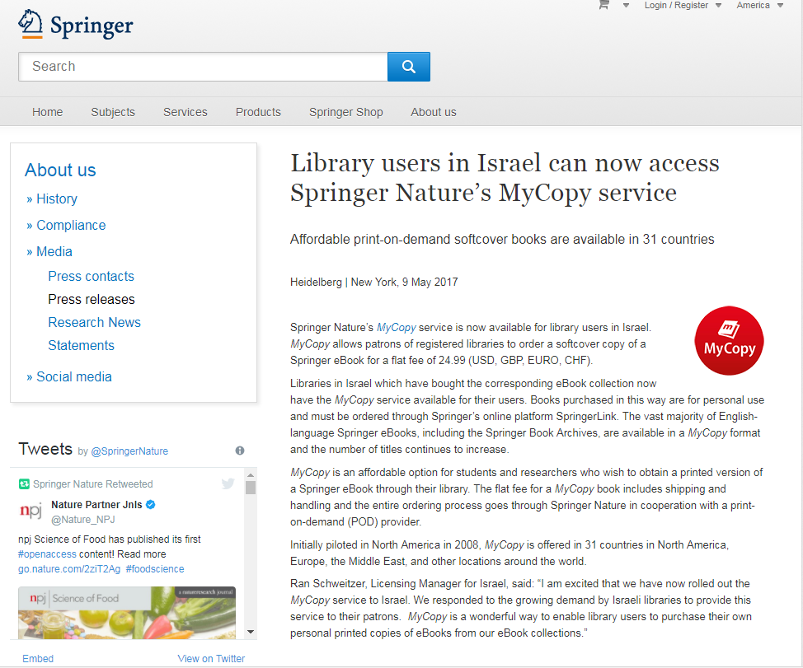
MyCopy

Slide 20
Working with Springer - Journals
Before you start writing
Writing your paper
Submitting your paper (what editors look for) – no double submissions!
Responding to editors and reviewers
Dealing with rejection – an average journal has 50% rejection rate!
Transfers / re-submitting

Slide 21
Journals

Slide 22
Selecting the Right Journal
Impact factor
Scope and audience
Reputation
Speed
Visibility
Open Access
Indexing
Peer review model
Open access

Slide 23
Selecting the Right Journal

Slide 24
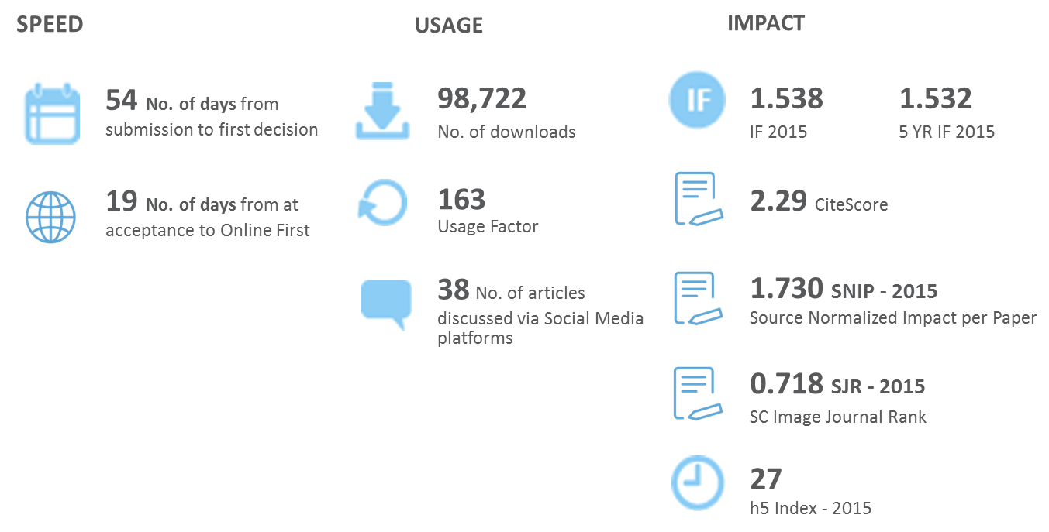
Metrics & Tracking
Usage
Impact
Citations

Slide 25
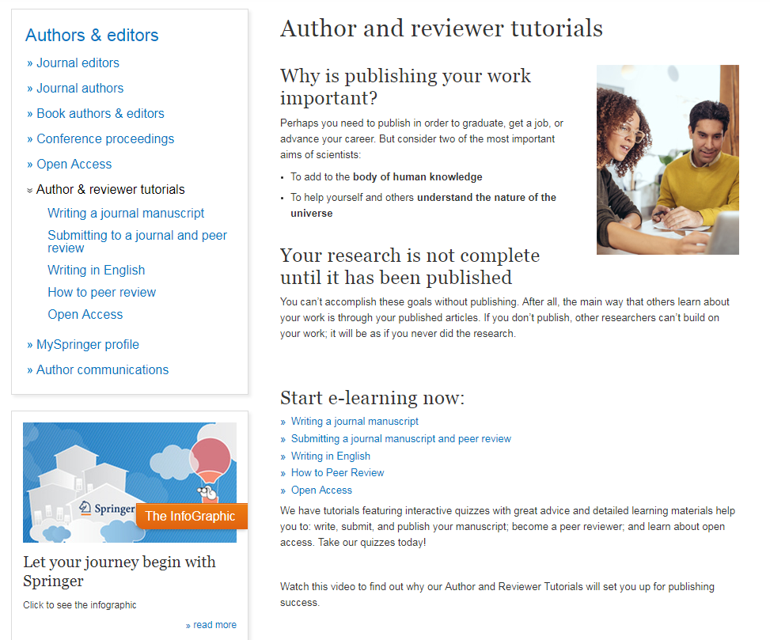
Author Academy

Slide 26
Marketing

Slide 27
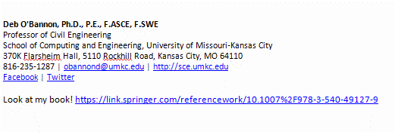
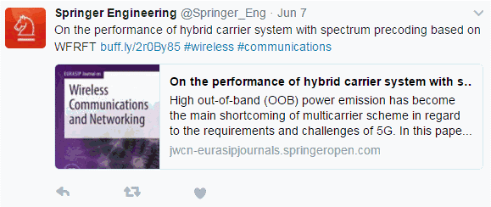
Marketing

Slide 28
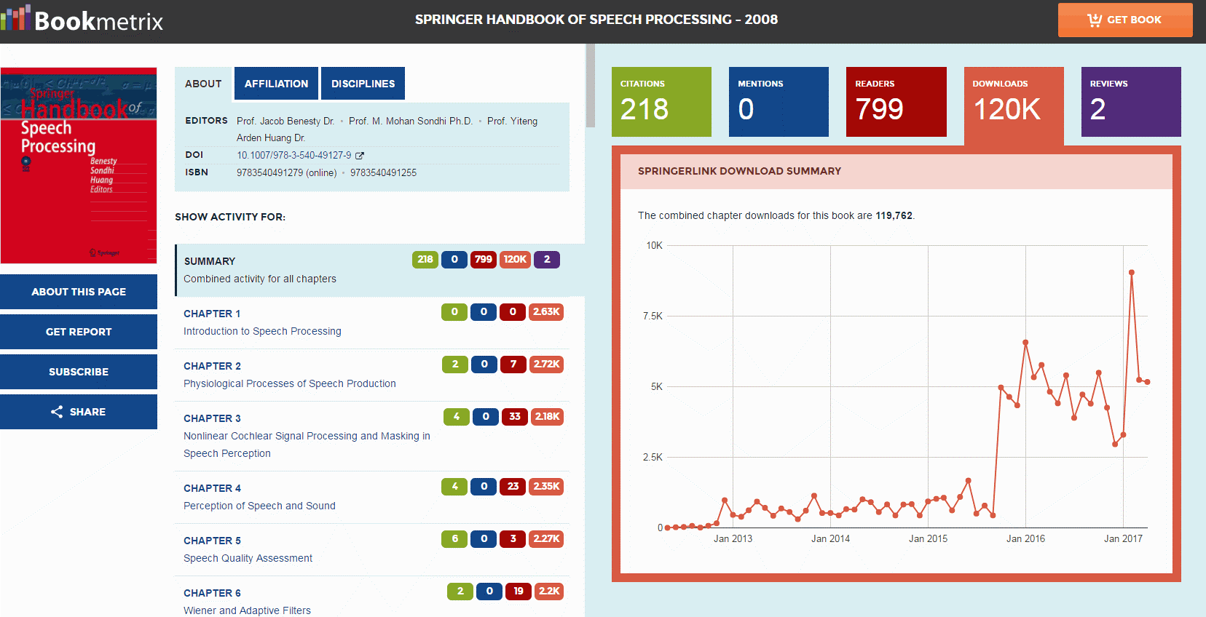
Metrics & Tracking

Slide 29
How to Begin…
Contact:
Mary E. James
Senior Editor
mary.james@springer.com
+1-212-460-1687

